Slide 1
Android-based Tutor-finder system
Aastha Hurkat (0827IT151002)
Amay Dubey (0827IT151013)
Avinash Jaisingh (0827IT151023)
Divesh Sharma (0827IT151031)
Ishan Sharma (0827IT151046)
Kajal Dhanotia (0827IT151050)

Slide 2
Contents
Abstract
Introduction
Problem Statement
Survey of existing Systems
Project Objectives
Solution Proposed
Models and Diagrams
Implementation
Conclusion
Limitations

Slide 3
Abstract
This project will help in reducing the manual tiredness of marking attendance manually. Also, the overall cost of this project will be minimised because there is no GSM modules being used, instead, RFID with tags and cards will be used. A unique RFID tag will be provided to each member having the 8-digit code which will be scanned through an RFID reader and the attendance will be entered in the database. The database used will be MySQL and for bridging server side and client side, PHP will be used.

Slide 4
Introduction
The project focuses on day to day problem faced by students to find
tutors and also provides a platform to tutors to increase their reach
without spending on advertising. Students and Tutors will be preferred
based on their geographic locations. Feedbacks will be provided by
students to tutor(s) in the form of “Star Ratings” which will help other
students to choose among the pool of tutors.
This specific topic is chosen because students face a lot of problem in
finding tutors, also some people have time and skills to teach but find it
hard to find students.
So, this project will bridge the gap between students and tutors.

Slide 5
Problem statement
Suppose a person 'X' is currently in higher studies or looking for job. Now he has to bear more or less of his expenses. Tuition finder will help him find a tuition where he can use his educational skills and experiences.
Now, let a person ‘Y’ is a concerned guardian or student who is desperately seeking for someone with proficient skills and knowledge to help in his study.
This app will help them finding what they want. This app will also facilitate them with the privilege of finding tutor/tuition associated with subject preference, location, salary etc.

Slide 6
Survey of existing systems
Sno | Existing system | Features | Disadvantages | Limitations
 | www.tutor.com | Online tutoring available, feedback system | Only online functioning, only website | Does not categorize students based on their location.
2. | TutorFinder Application | Chat system available | No verification/validation of tutors | Not popular in India
3. | BuddySchool.com | Website based, student feedback available | Limited number of subjects | Not functional in India, Only website functioning

Slide 7
Project Objectives
To bridge the gap between students and tutors.
To develop an android application to bring students and tutors on a common platform.
To categorize tutors based on their geographic locations.
To ensure that tutors are entering verified and genuine information.
To recommend tutors for students based on their feedbacks/star ratings.

Slide 8
Solution Proposed
To solve this problem we can develop a system which takes information regarding the educational requirements, exact location, suitable salary, tuition days in a week and so on. It will facilitate the communication between two potential parties in a tuition. The guardian can also state which things are negotiable and which are mandatory.

Slide 9
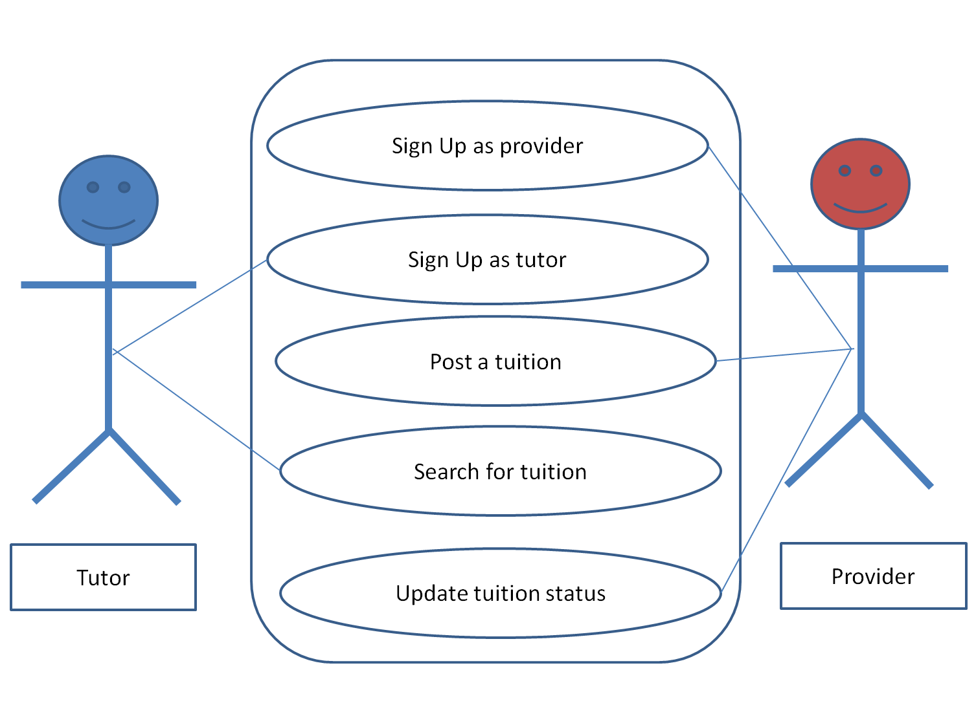
Models and Diagrams
Use Case Diagram

Slide 10
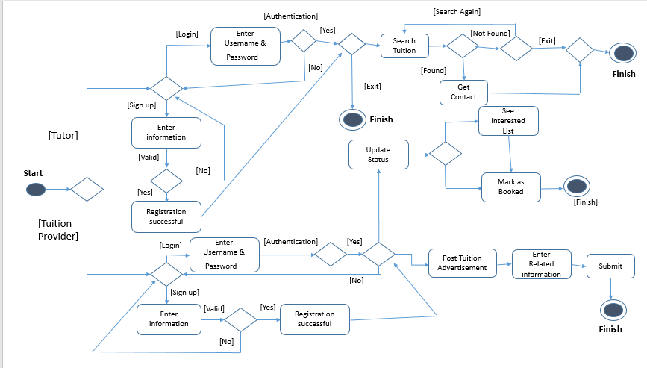
Activity Diagram

Slide 11
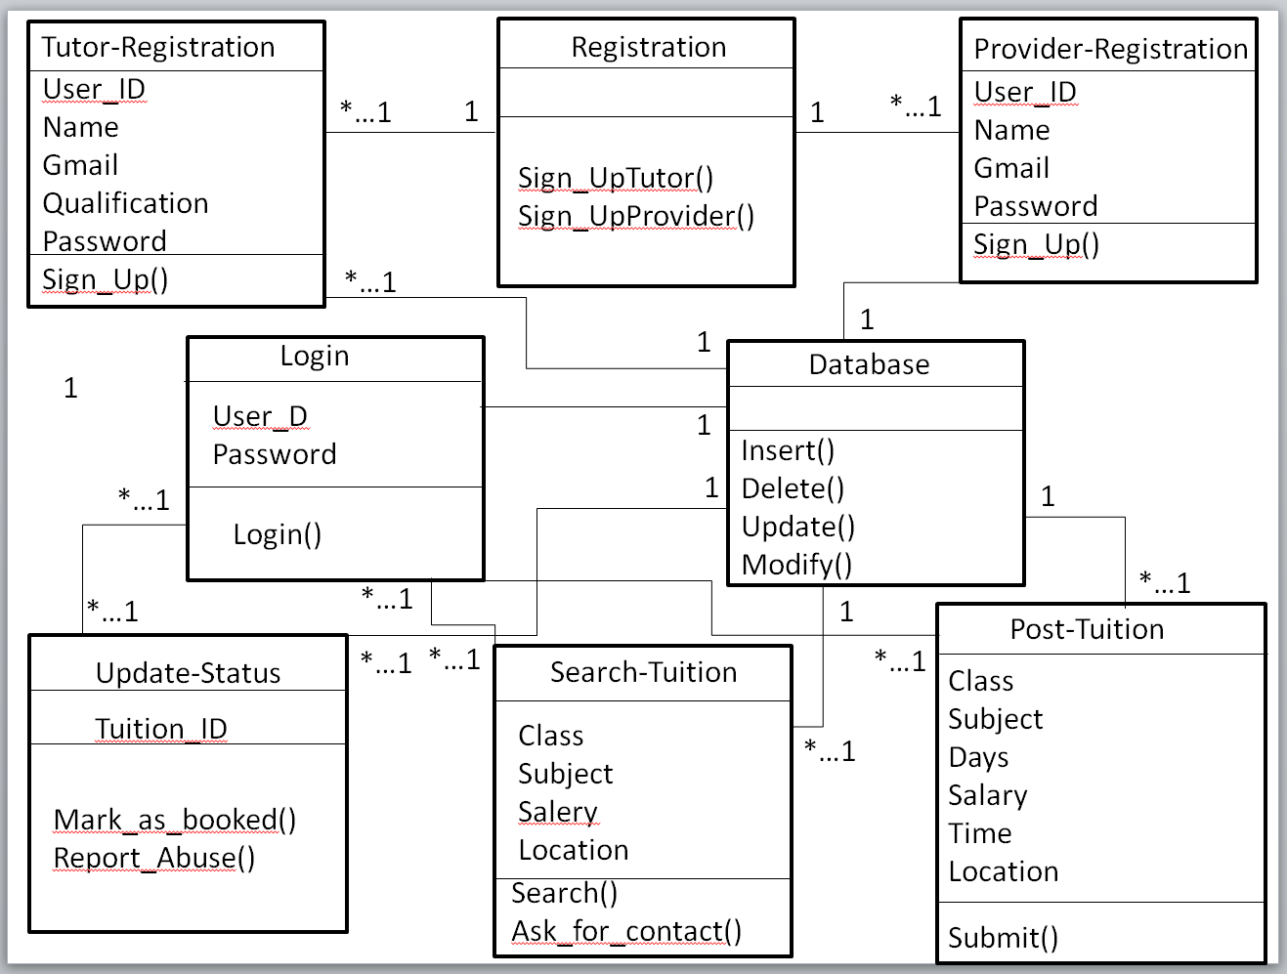
Class Diagram

Slide 12
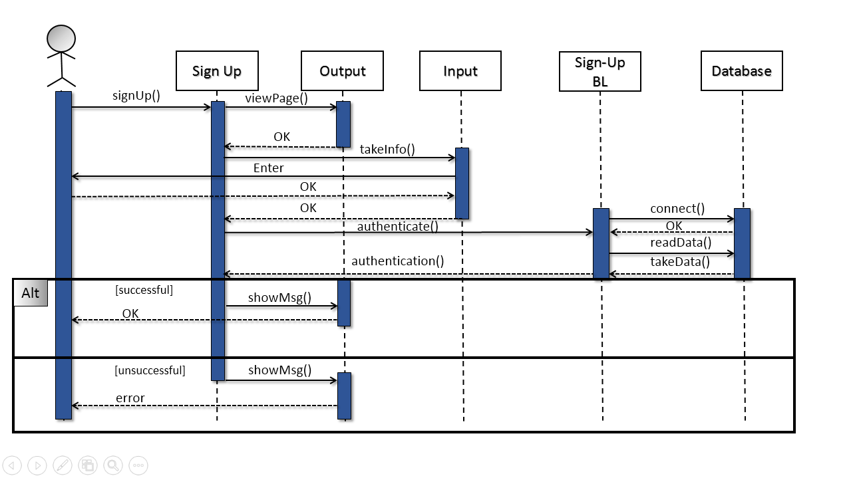
Sequence Diagram

Slide 13
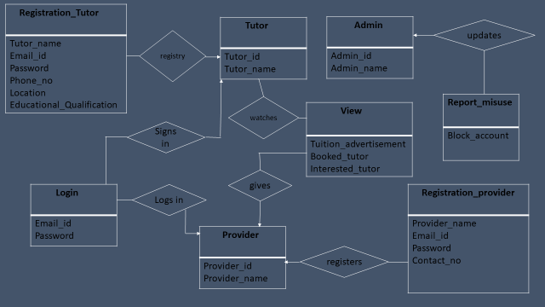
E-R Diagram

Slide 14
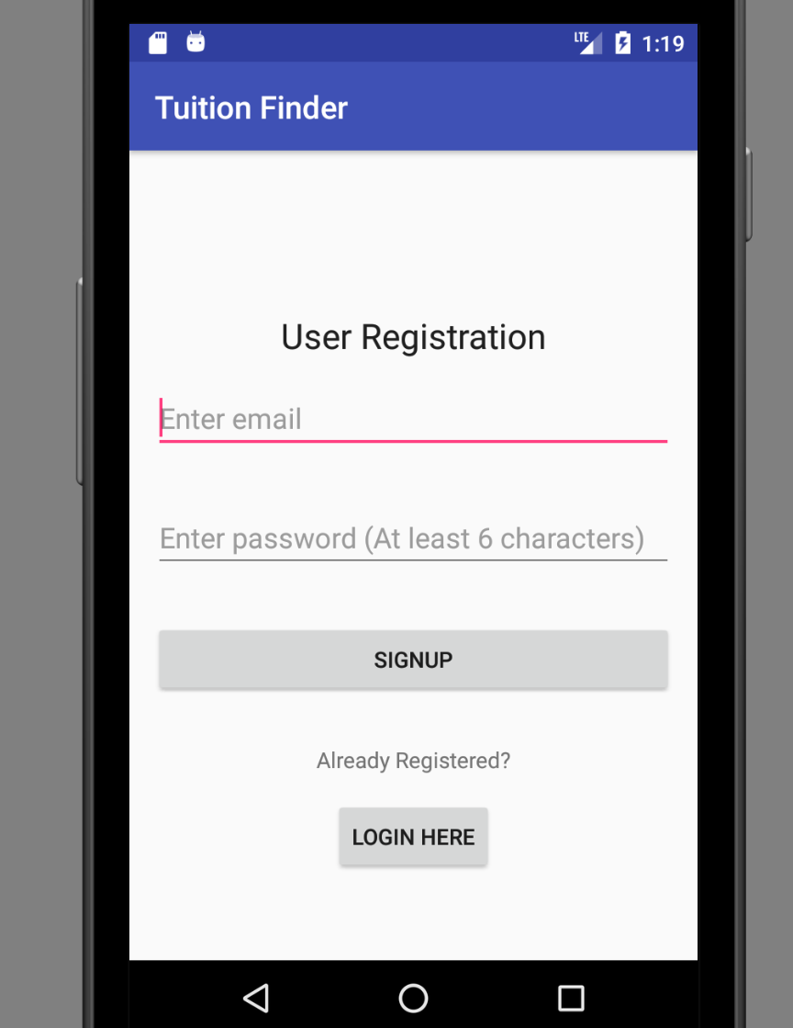
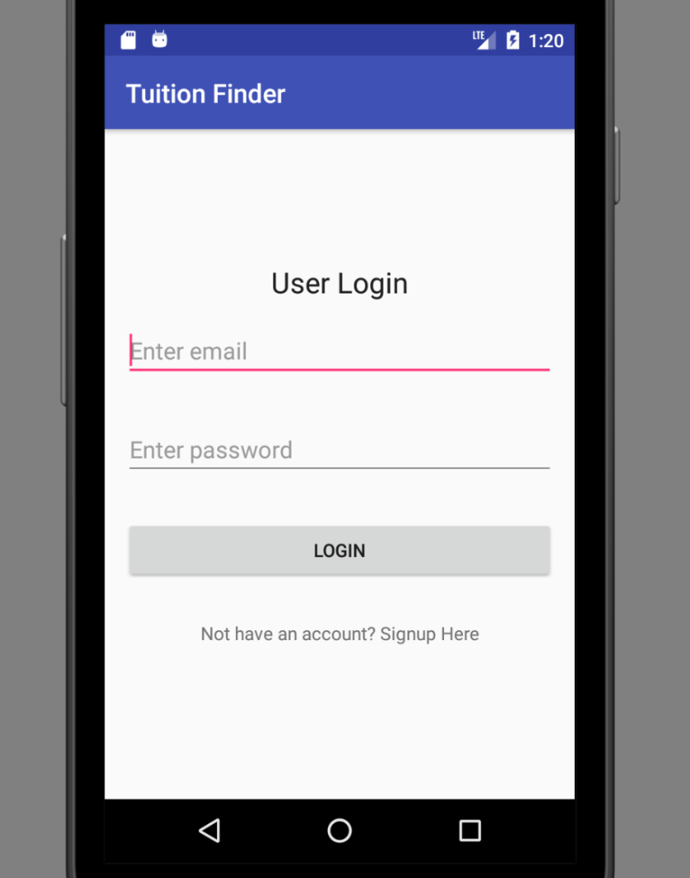
Implementation

Slide 15
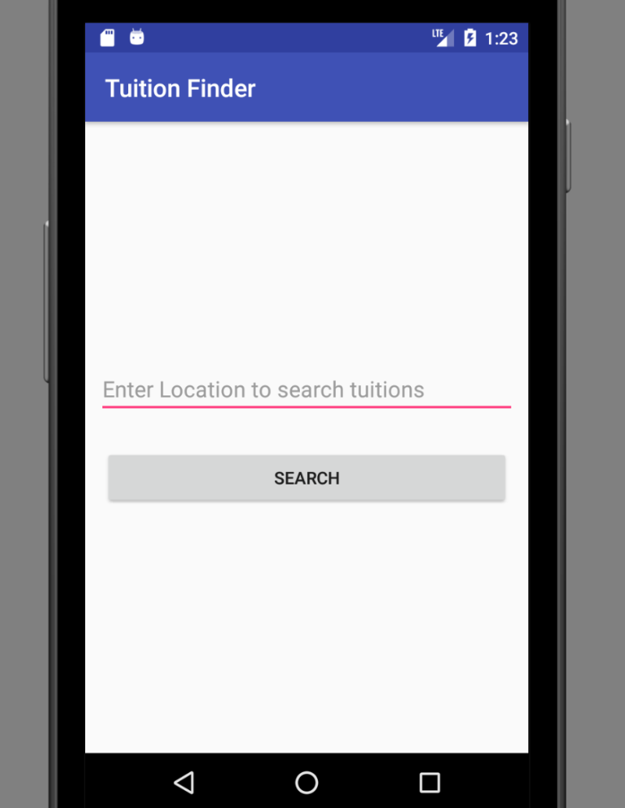
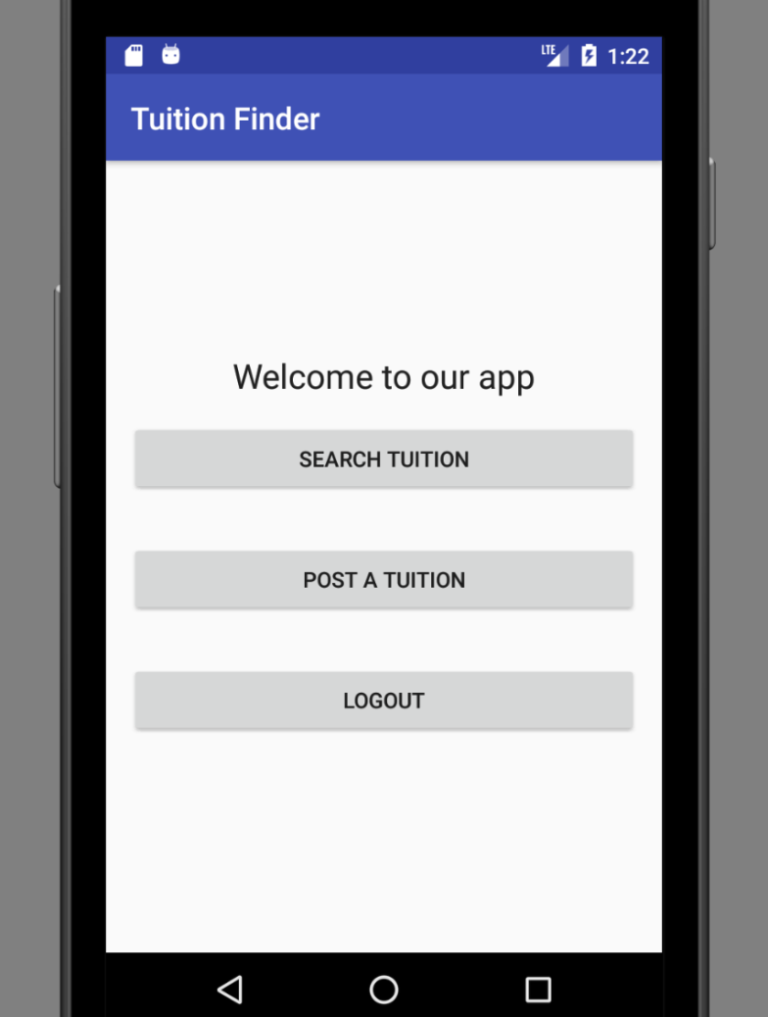

Slide 16
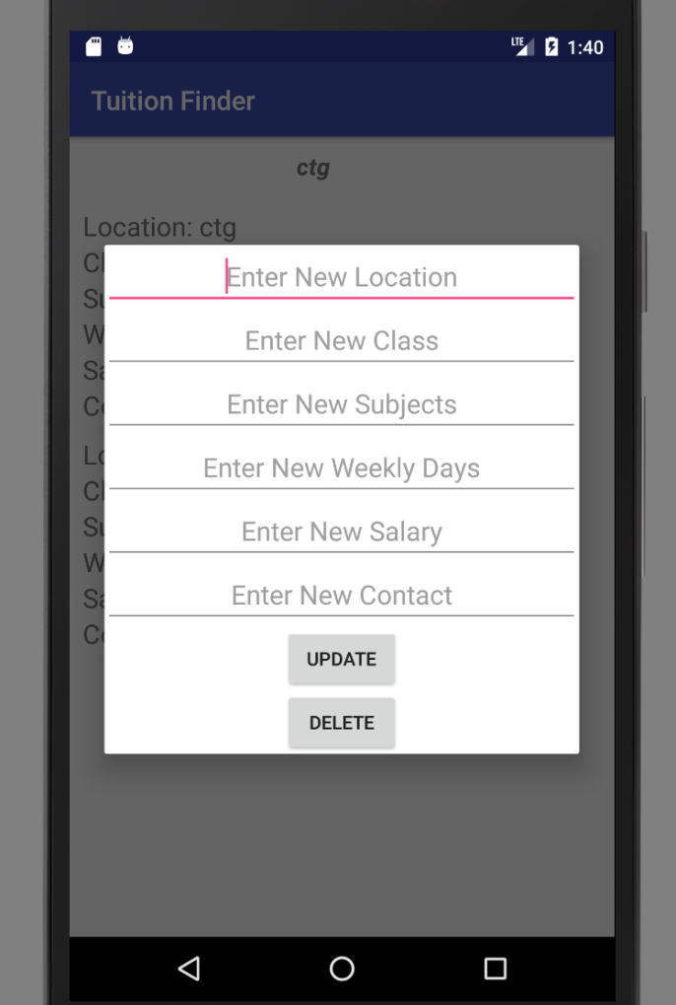
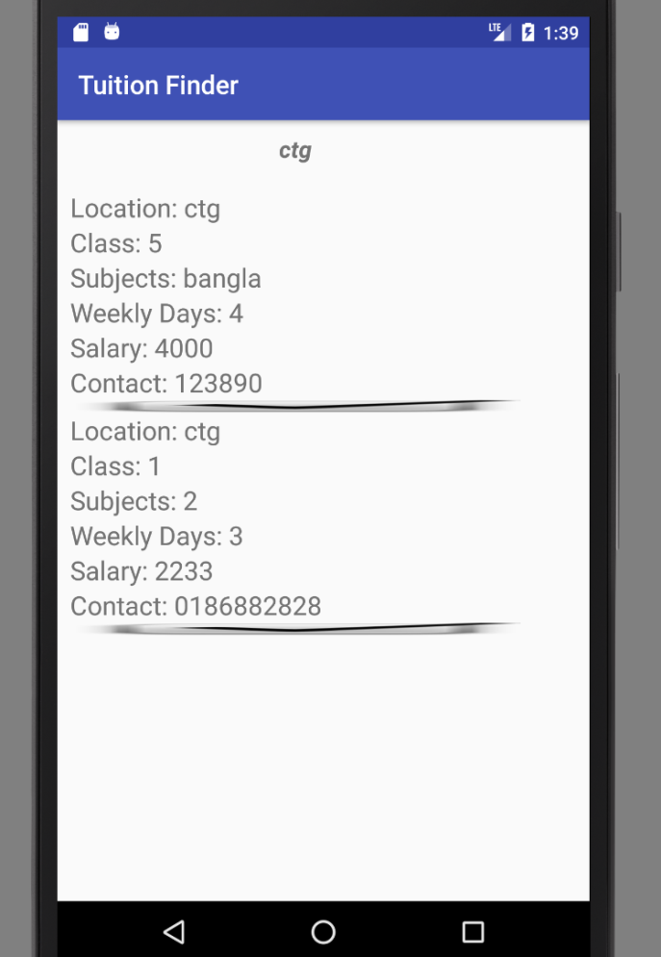

Slide 17
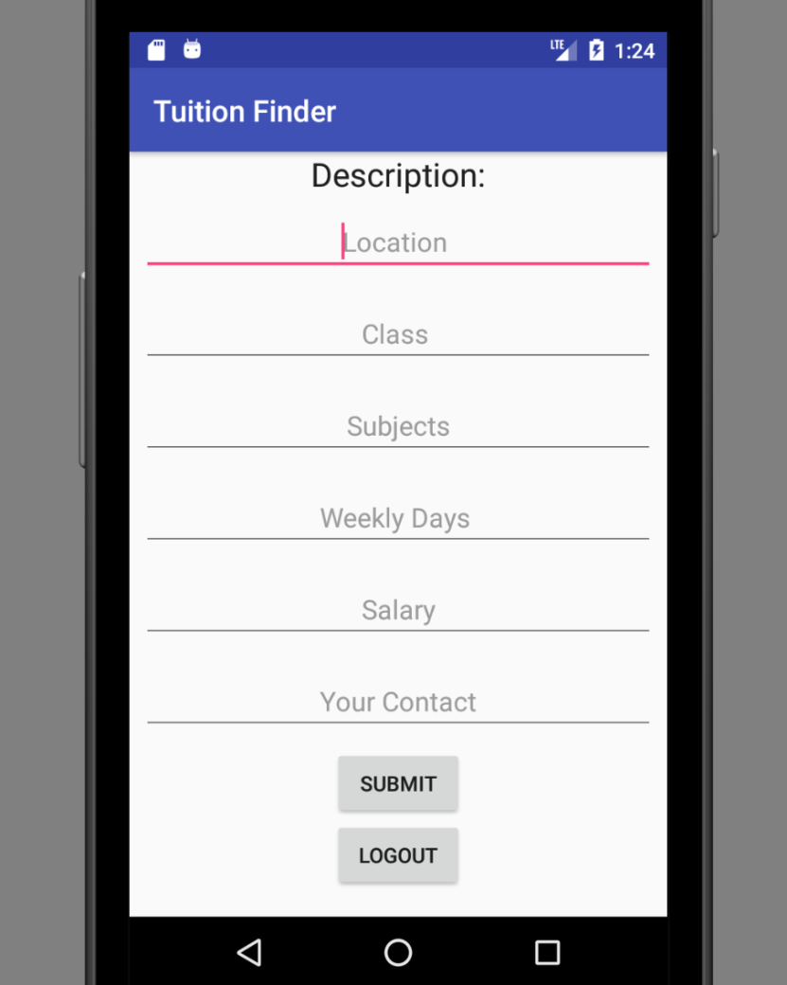

Slide 18
Conclusion
With the help of this project we will try to make a platform for tutors and students. The features like finding tutors with the help of geographic locations, star ratings, etc. will make our project more efficient and user friendly. With proper marketing, we will deploy this application and will try to bring a change in educational industry.

Slide 19
Limitations
The limitation of our project is that initially we will not be recommending tutors to students until we start getting feedbacks.
Also, our application is not built for IOS users.

